Slide 1
British Grassland Society
Grassland Farmer of the Year 2022

Slide 2
The Finalists
BGS Grassland Farmer of the Year 2022
Claire & John Beckett
Ulster GS
Aled & Owain Rees
Cardigan GS
Jeremy Way & Kate Lywood
West Sussex GS

Slide 3
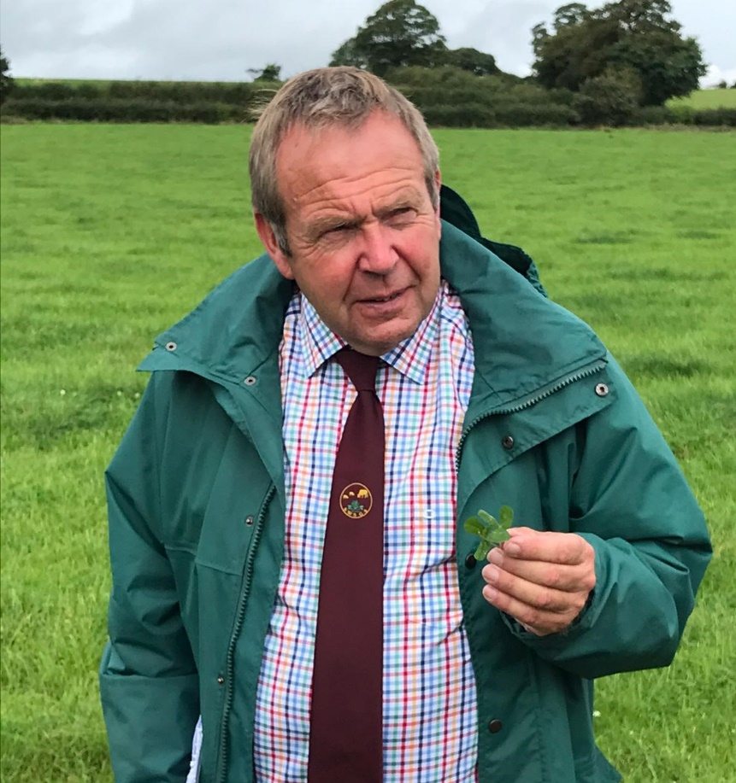
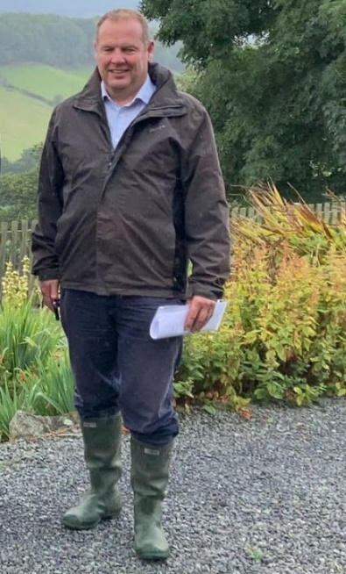
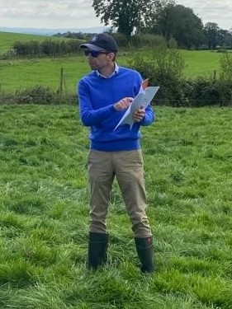
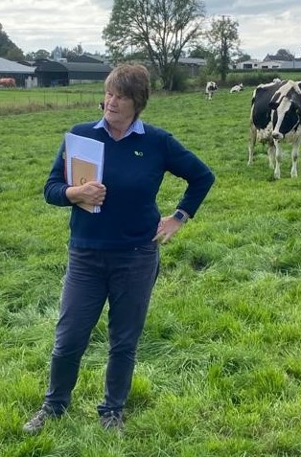
The Judging Panel
Marc Jones
Winner 2021
Brent Gibbon
Nufarm
Philip Cosgrave
Yara
Helen Mathieu
Germinal
Hugh McClymont
Head judge

Slide 4
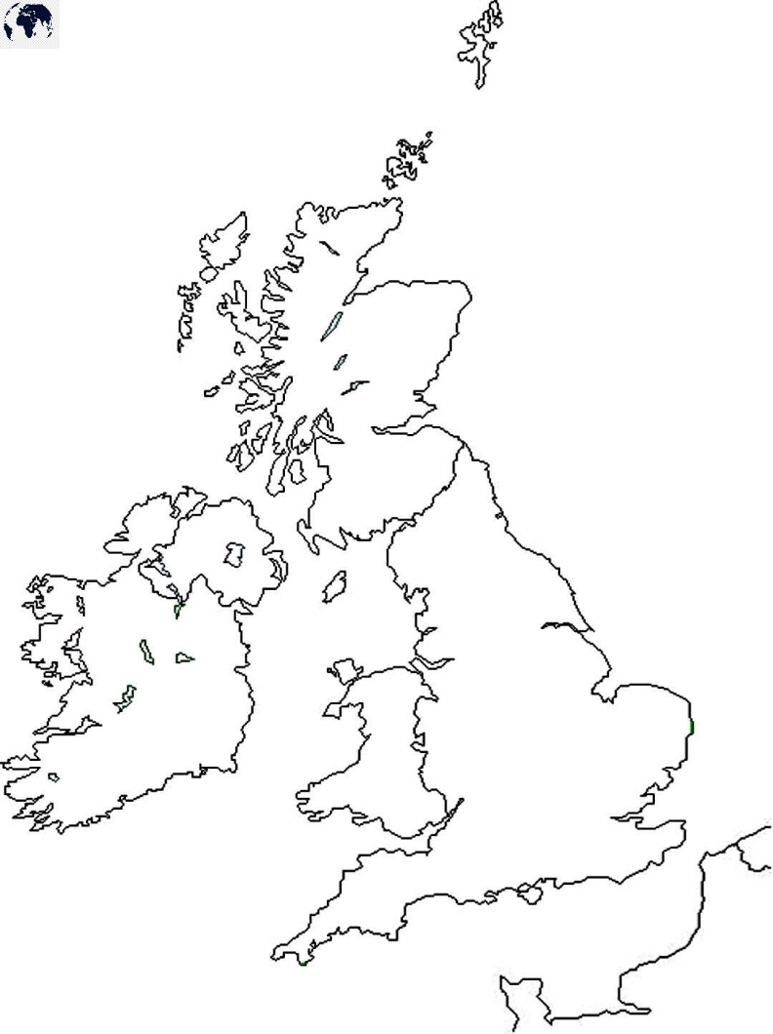
Farm 1
Claire & John Beckett
Ulster GS
Farm 3
Jeremy Way & Kate Lywood
West Sussex GS
Farm 2
Aled & Owain Rees
Cardigan & District GS

Slide 5
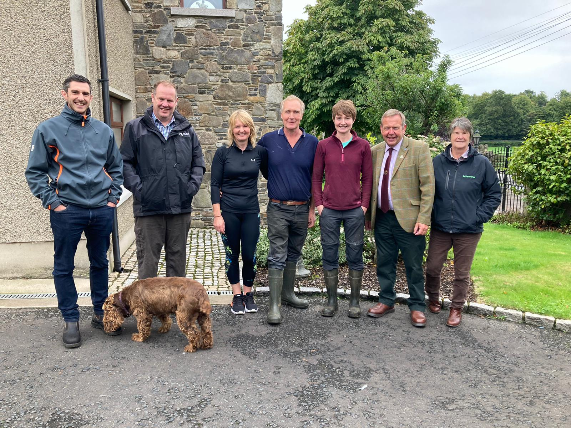
Farm 1: Monday 12 September
Claire & John Beckett
Donacloney
Craigavon
Ulster Grassland Society

Slide 6
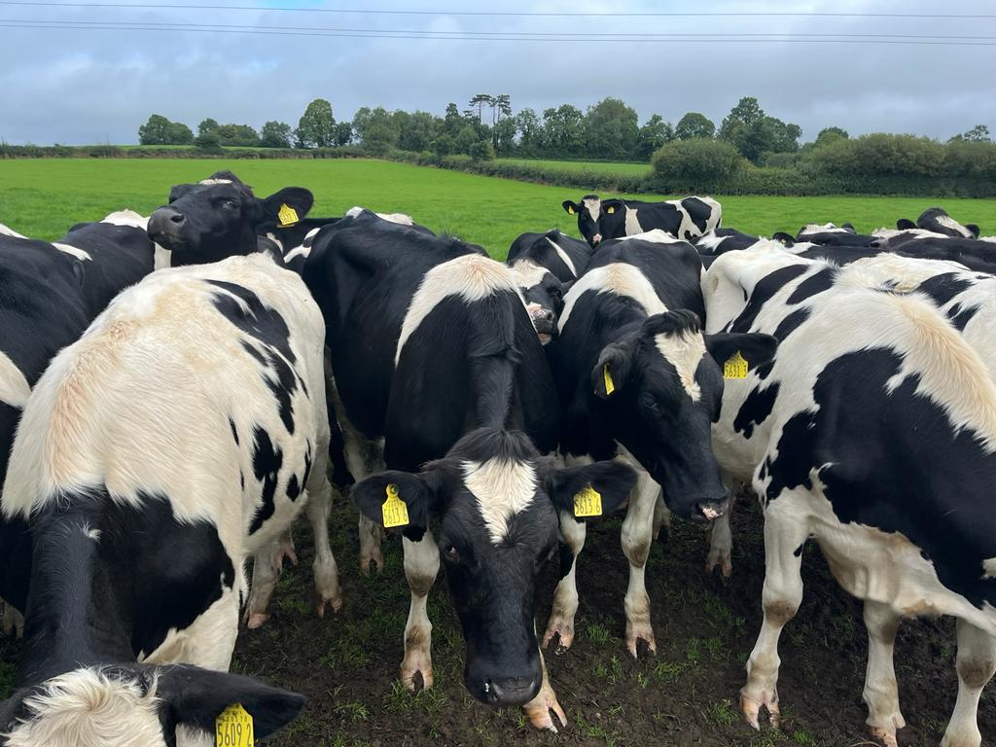
Farm size:
82 hectares (203 acres)
Altitude:
52 m (171 feet)
150 Holstein cows
Calving from September to April (70% in Sep-Nov)
10,332 litres/cow
3.173 litres from forage
Concs: 3217 kg/cow
SR 2.44 cows/ha

Slide 7
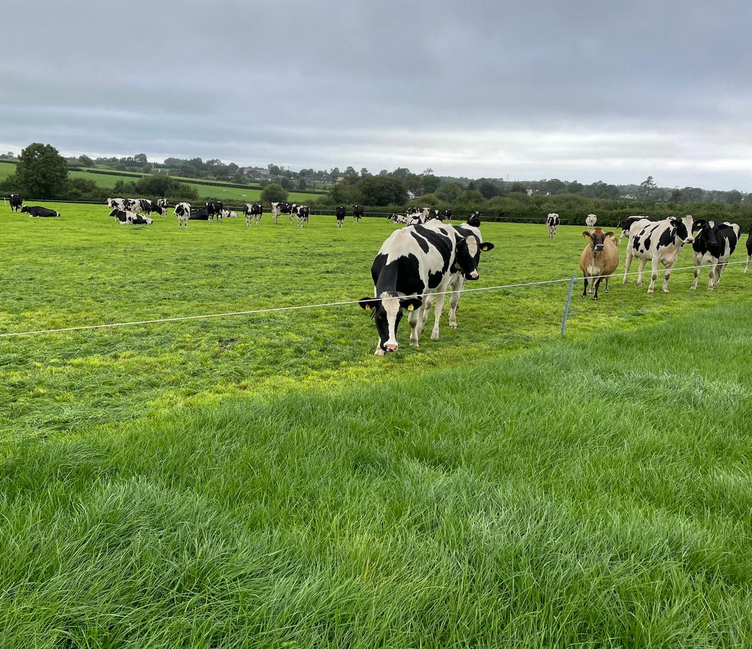
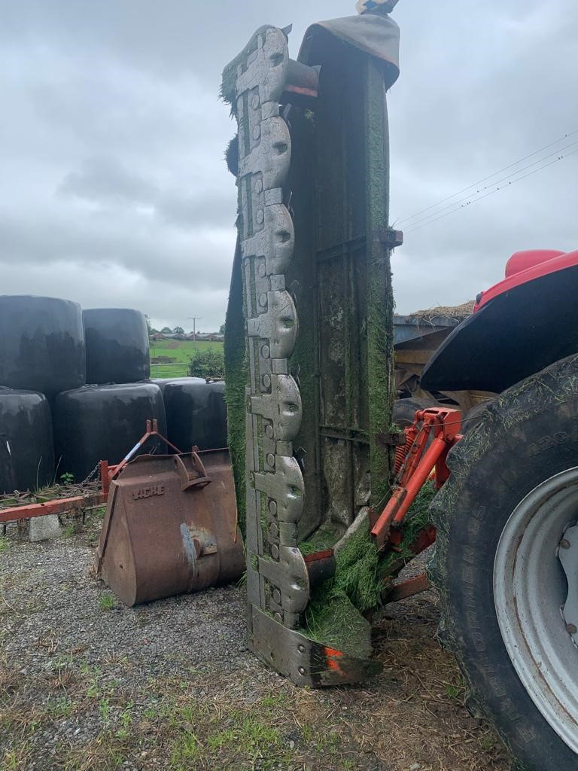

Slide 8
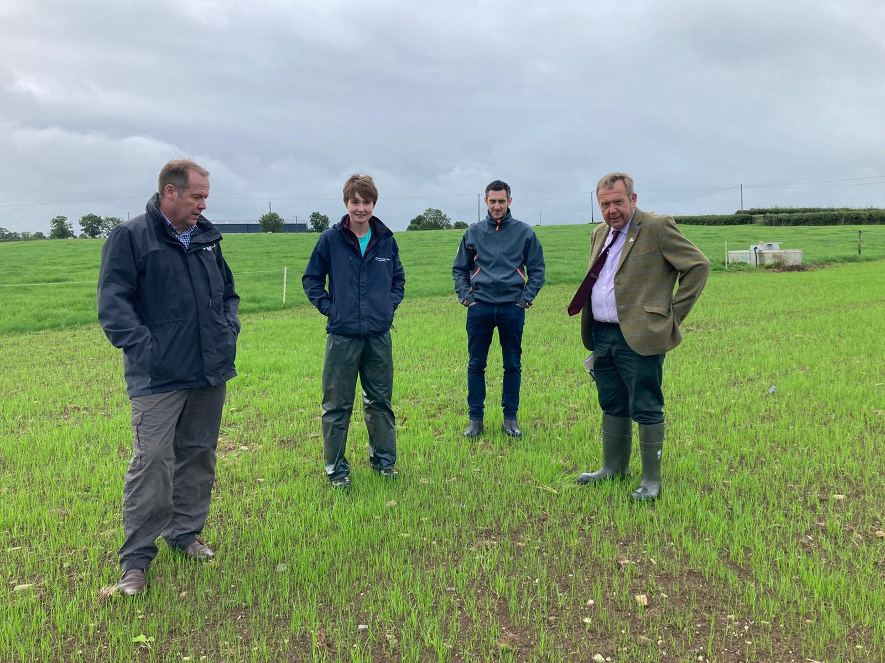
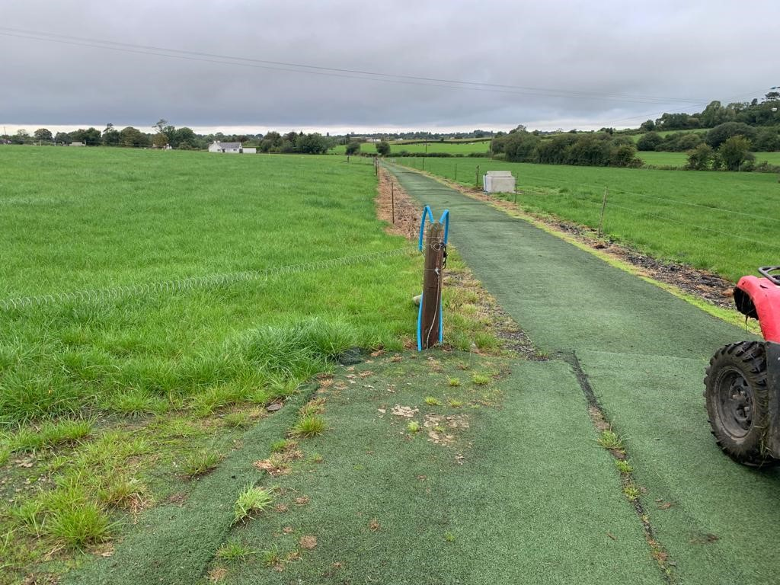

Slide 9
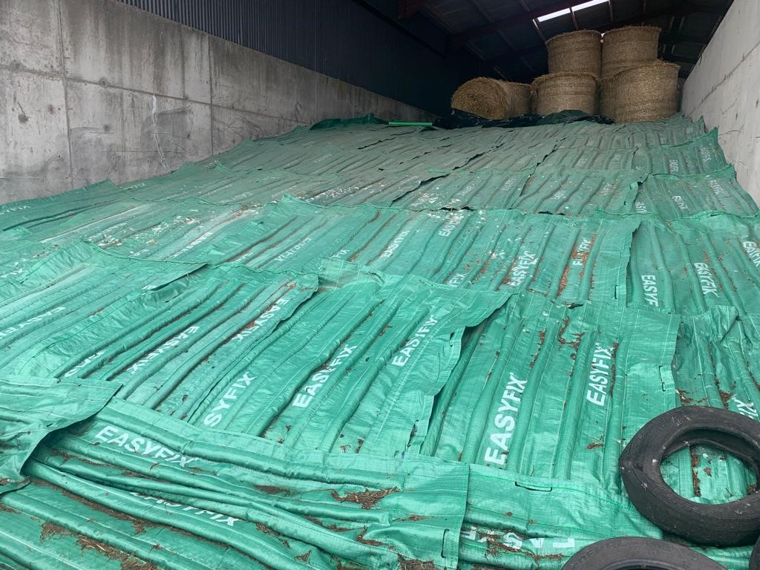
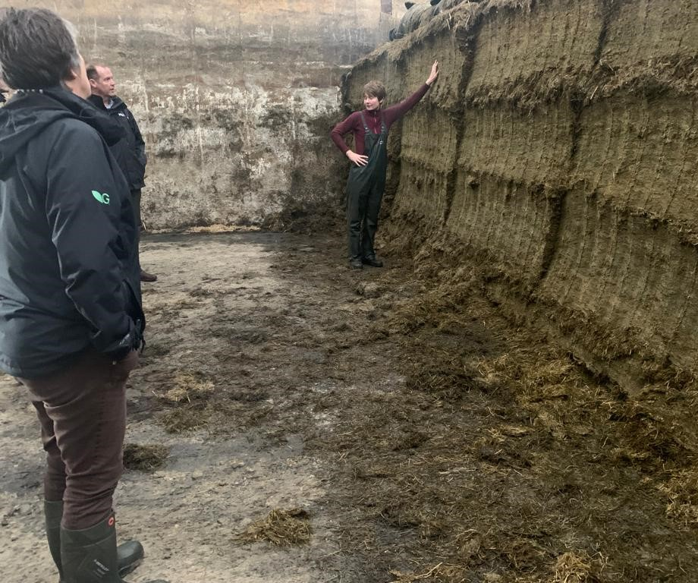
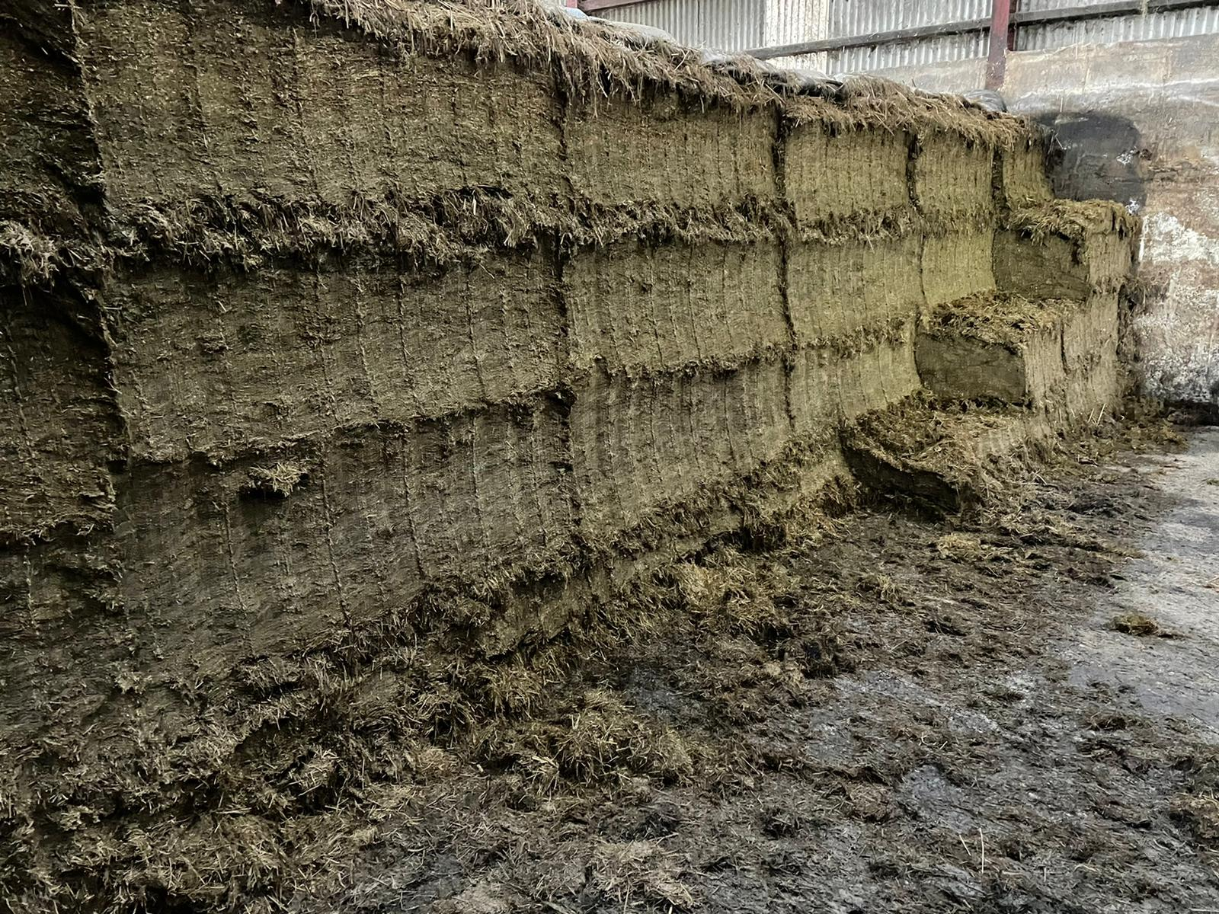

Slide 10
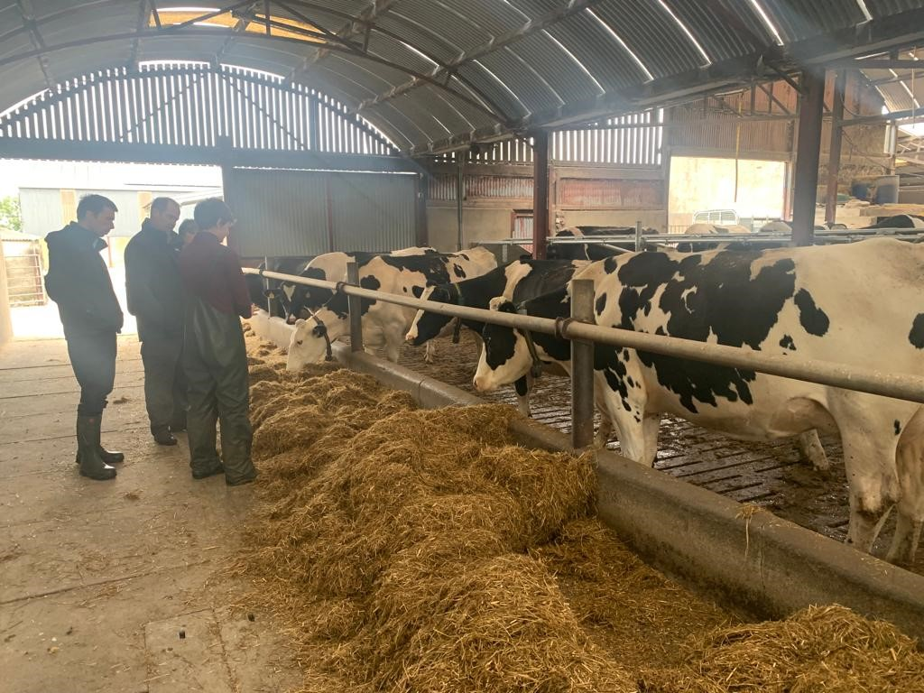
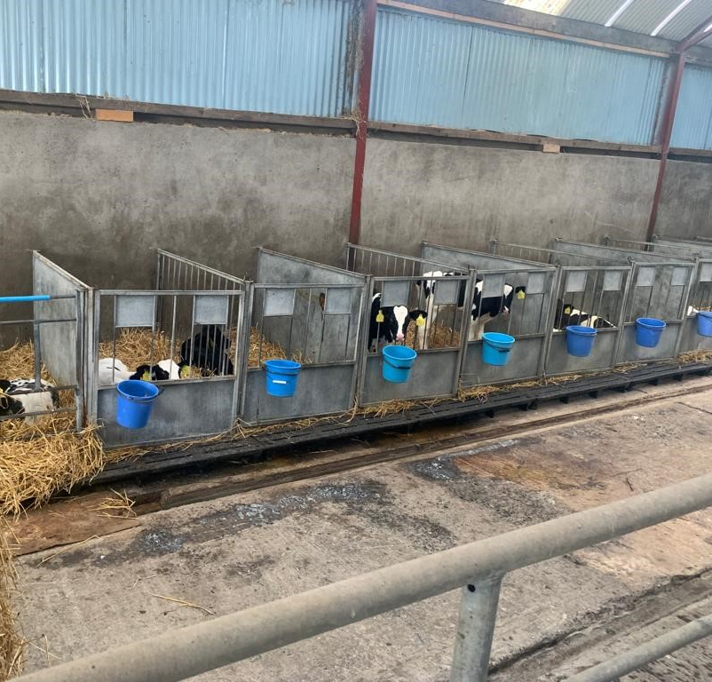

Slide 11
Farm 2: Monday 26 September
Aled & Owain Rees
Treclyn Isaf
Eglwyswrw
Crymych
Cardigan & District Grassland Society

Slide 12
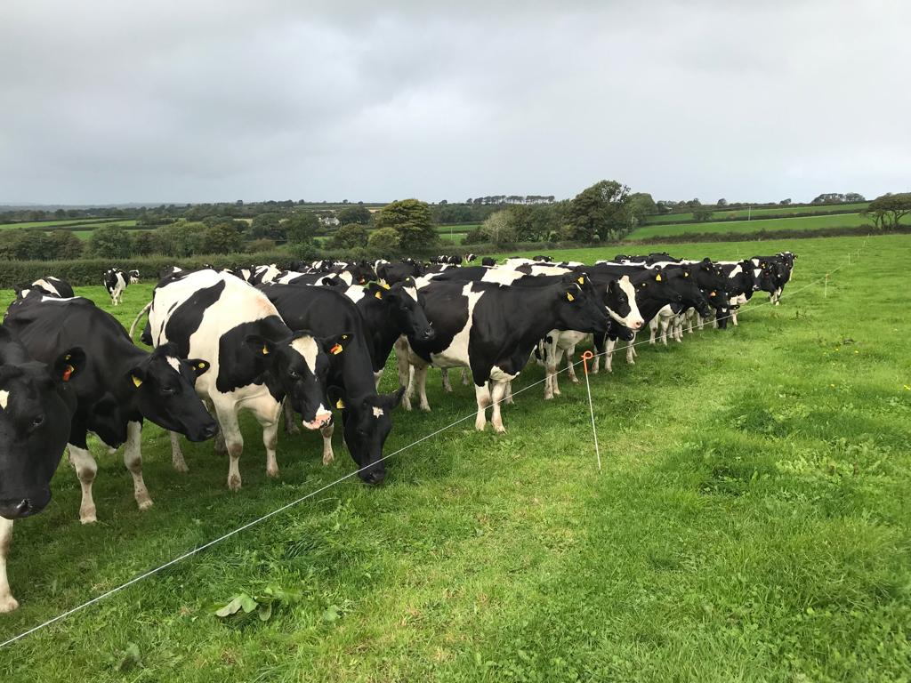
Farm size:
105 hectares (950 acres)
Altitude:
152 m (500 feet)
380 pedigree Holstein cows, 20 Jersey cross
Spring & autumn calving
7333 litres/cow
4010 litres from forage
Concs: 1661 kg/cow
SR 2.75 cows/ha

Slide 13
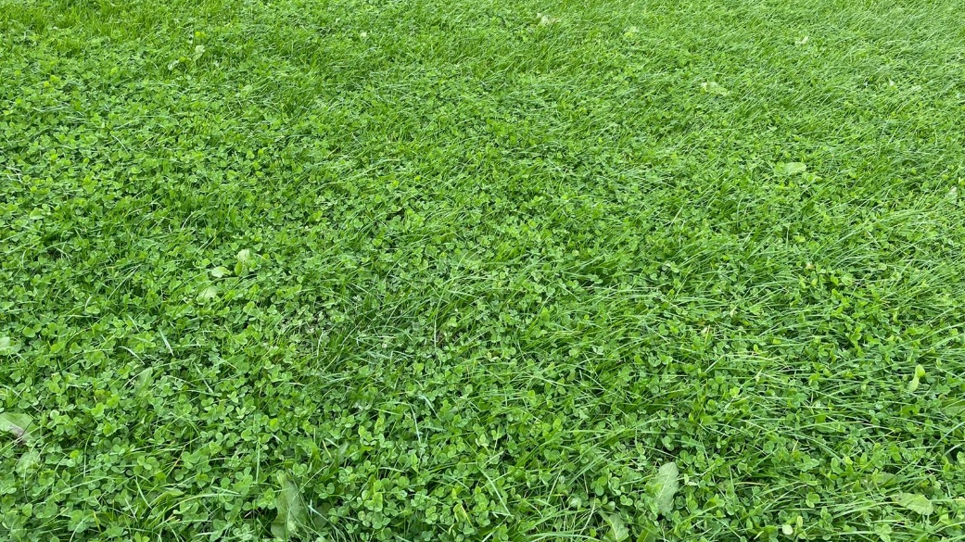
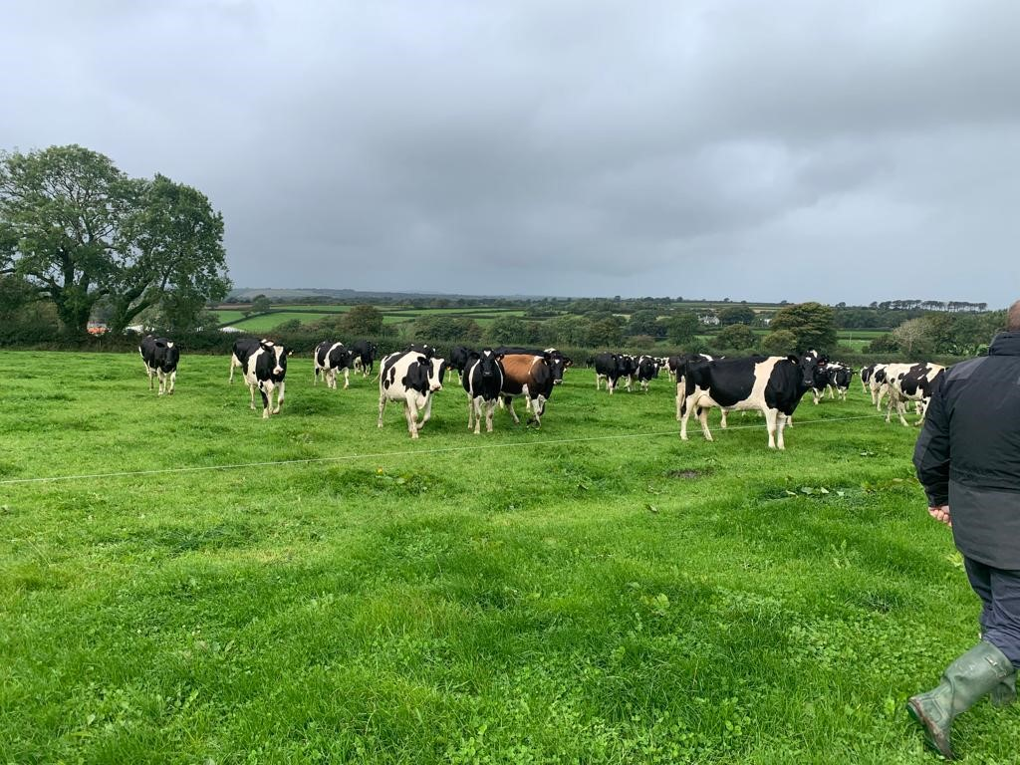
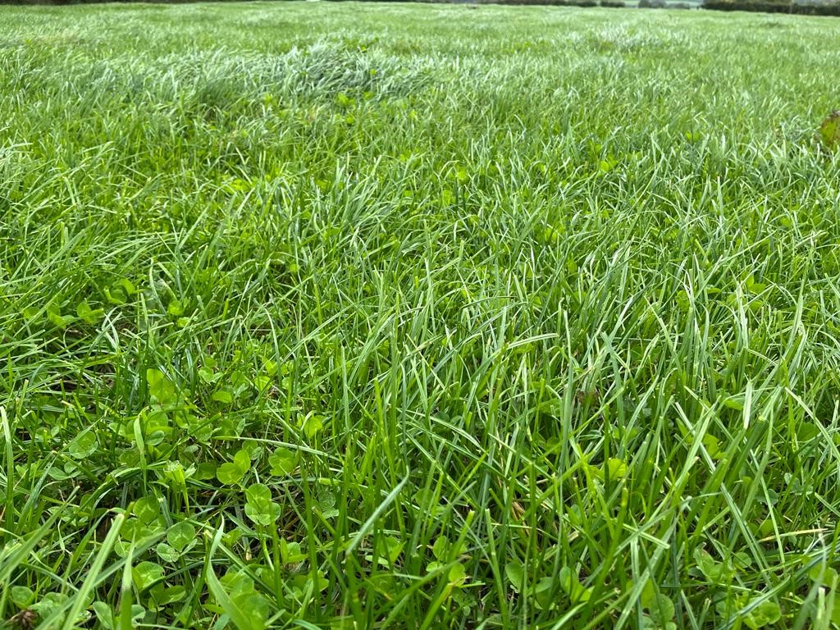

Slide 14
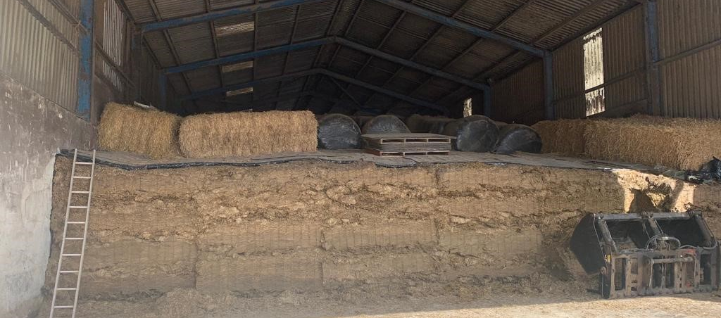
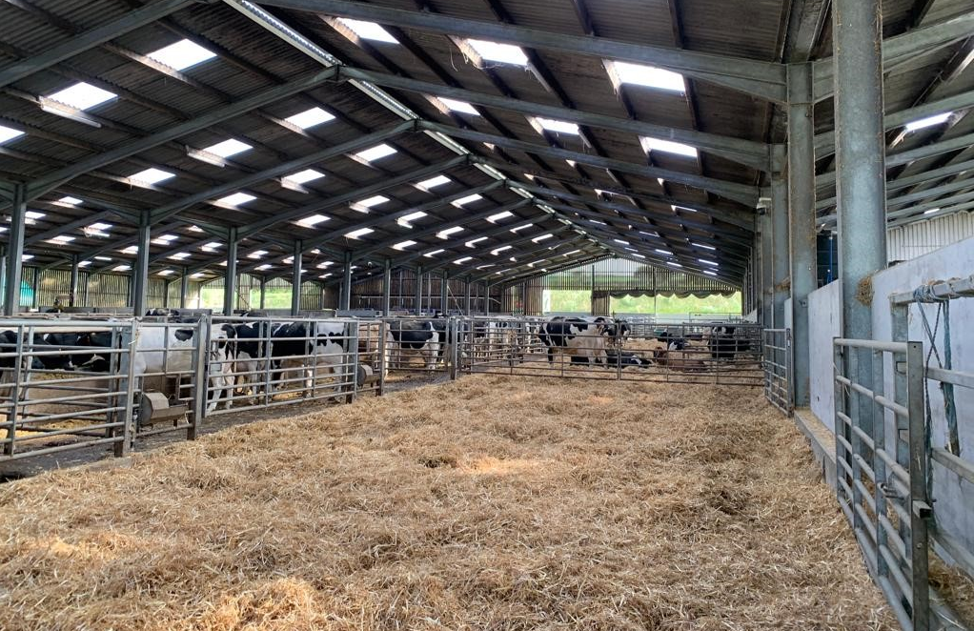
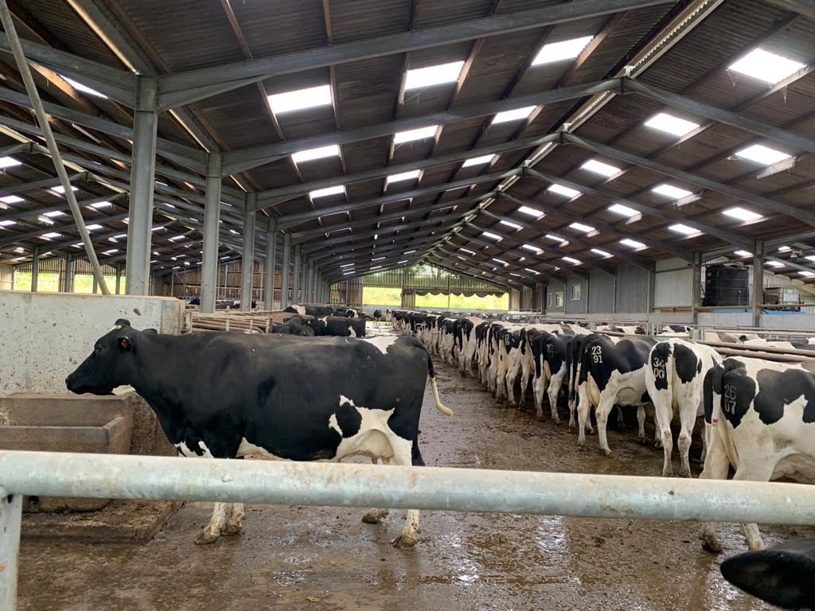
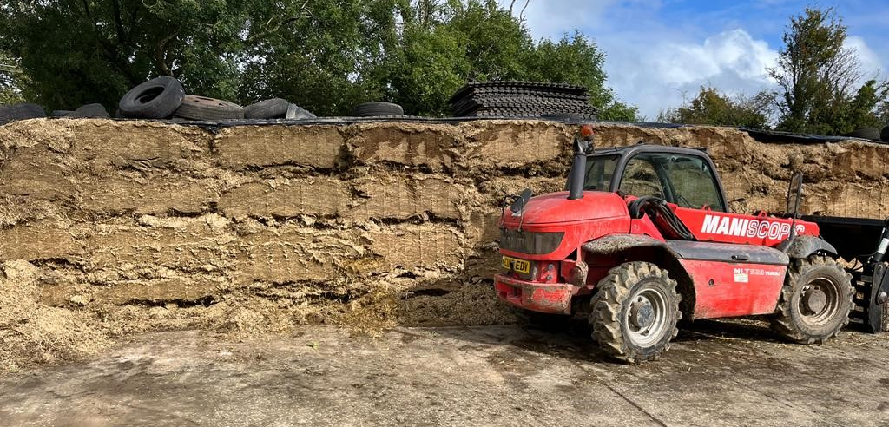

Slide 15
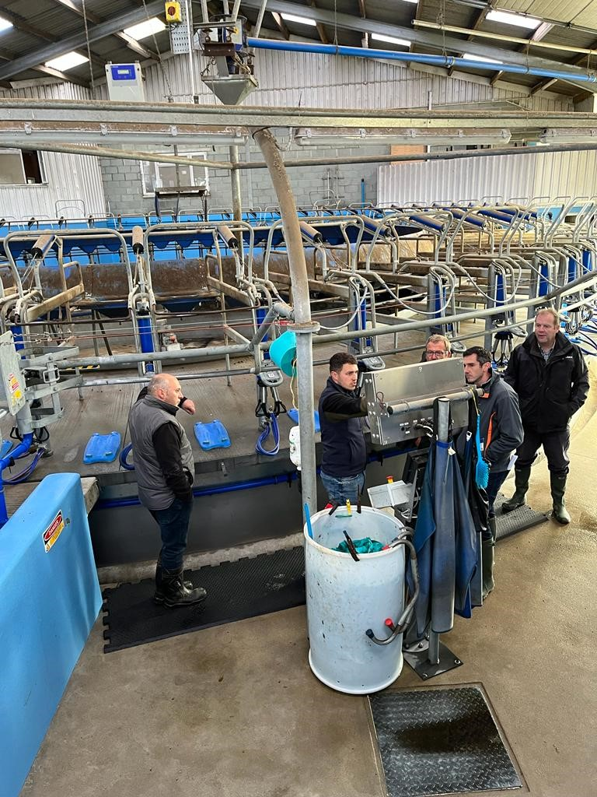
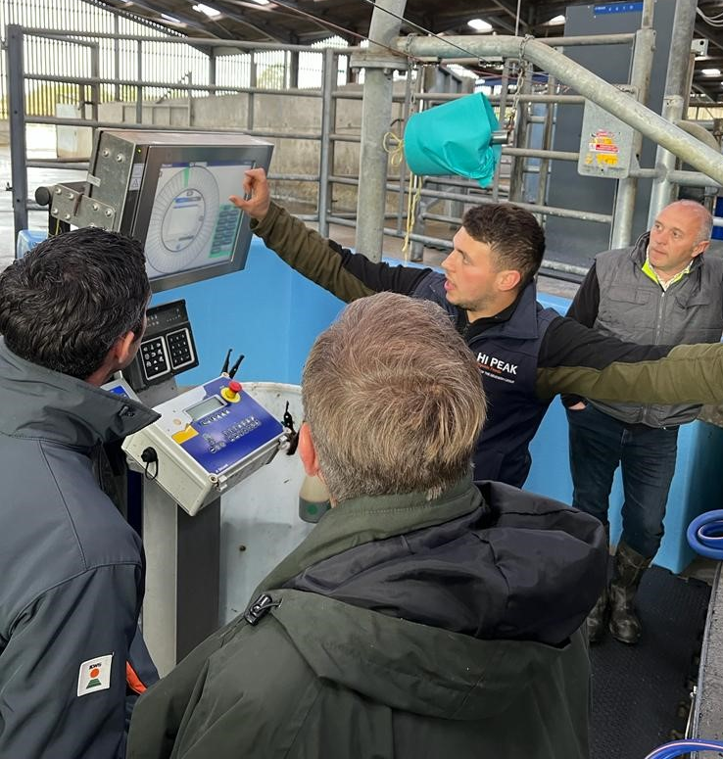
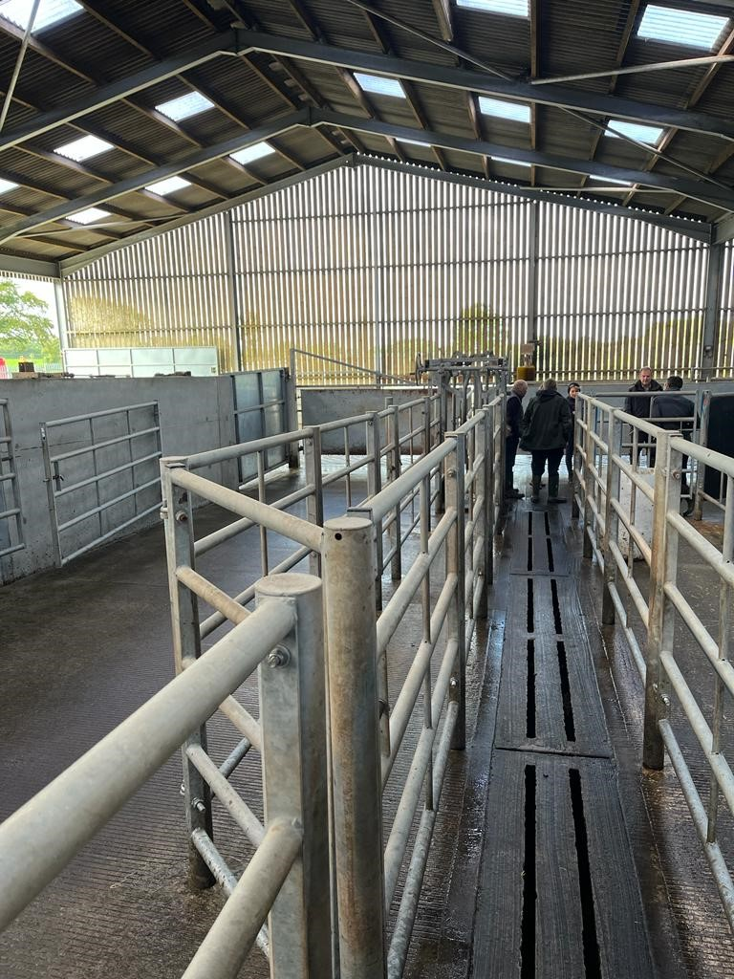
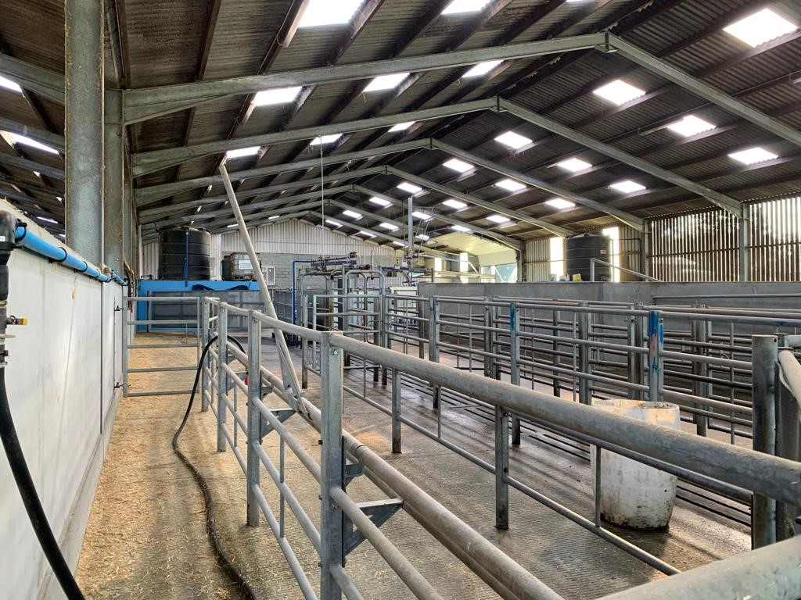

Slide 16
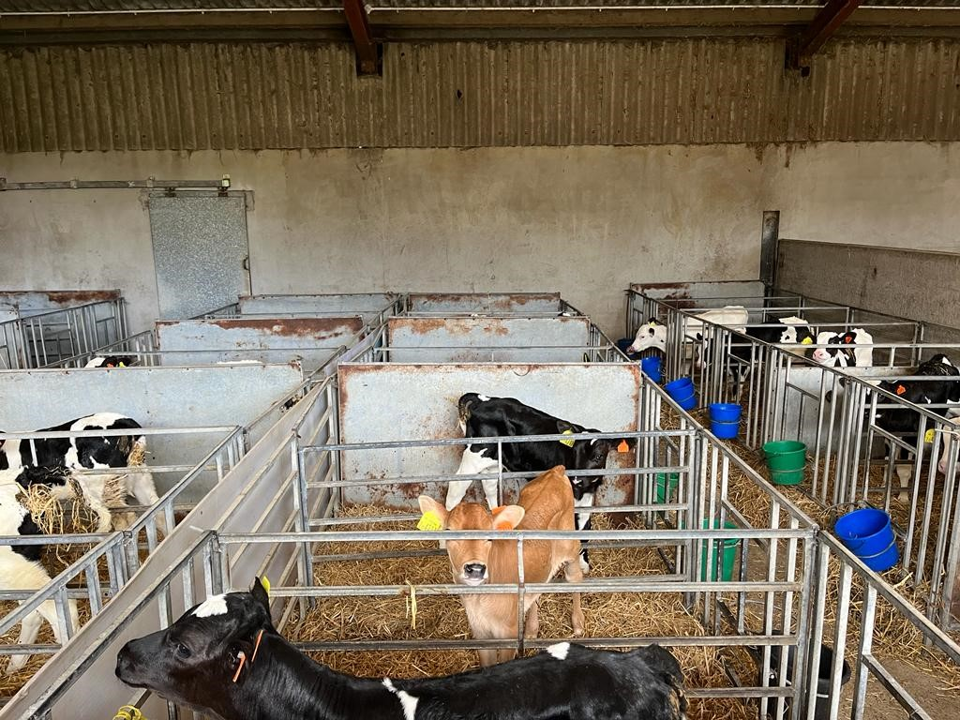
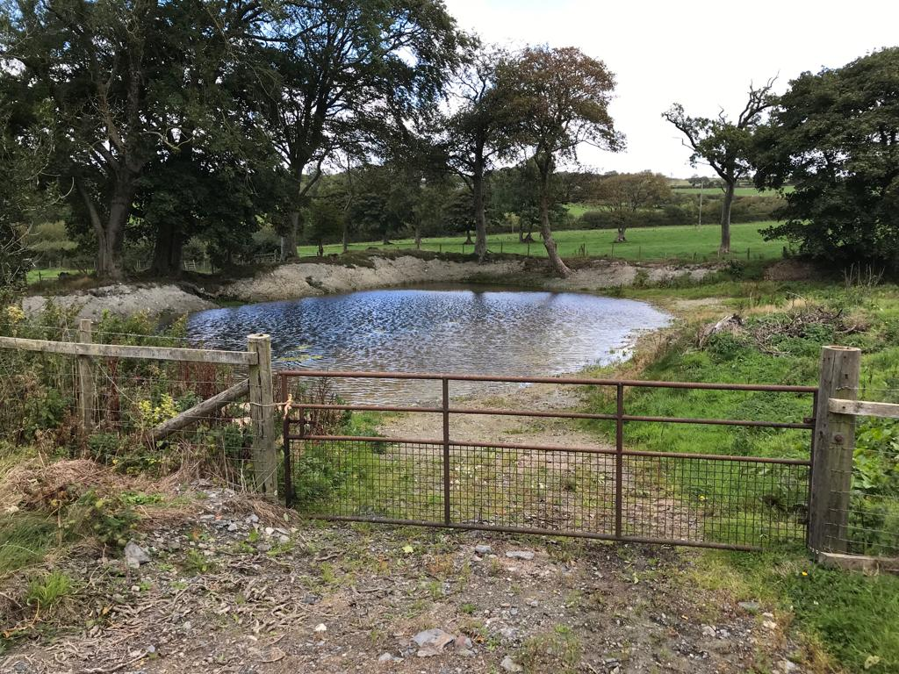
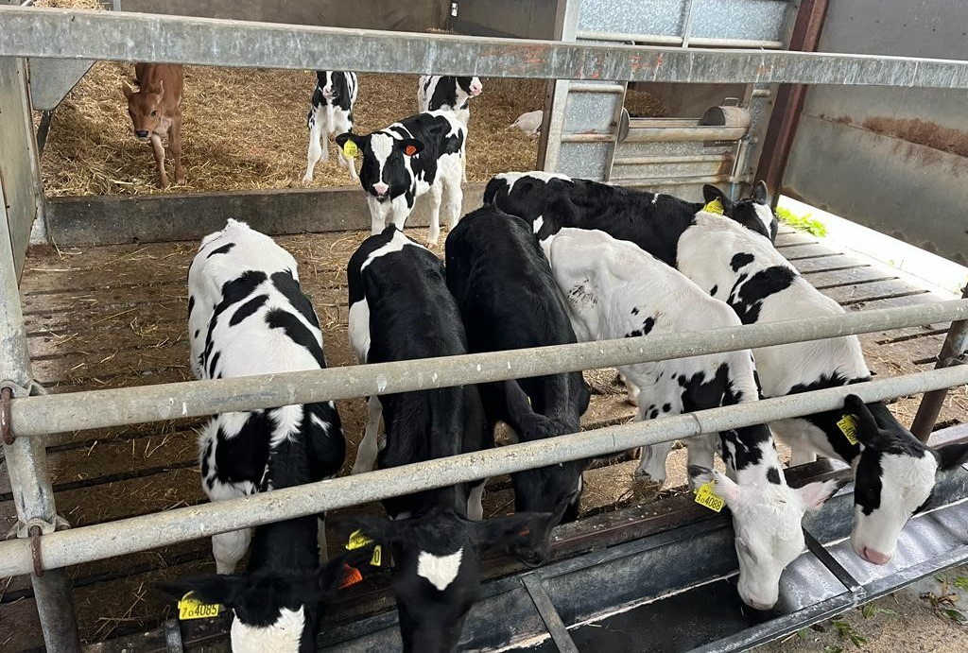

Slide 17
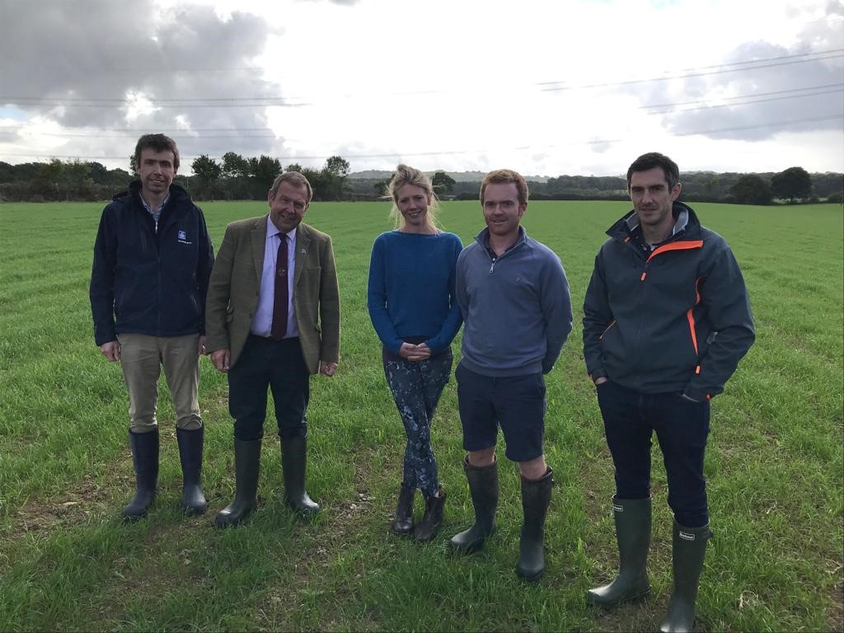
Farm 3: Tuesday 27 September
Jeremy Way & Kate Lywood
Marshalls Farm
Kirdford
Billingshurst
West Sussex Grassland Society

Slide 18
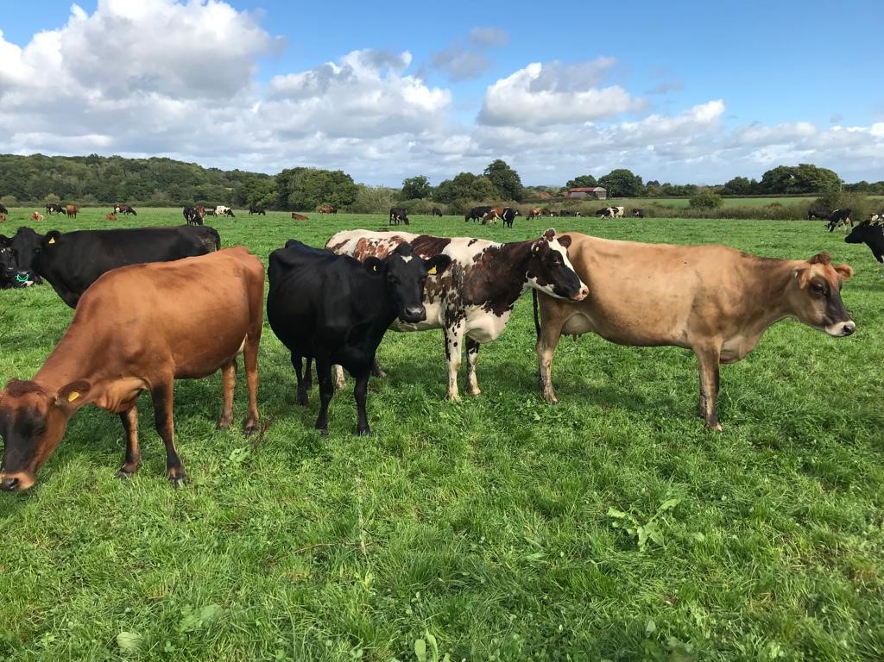
Farm size:
445 hectares (1100 acres)
Altitude:
40 m (131 feet)
320 crossbred cows (Friesian/Norwegian Red/Jersey)
Spring calving
5718 litres/cow
2997 litres from forage
Concs: 1289 kg/cow
SR 1.19 cows/ha

Slide 19
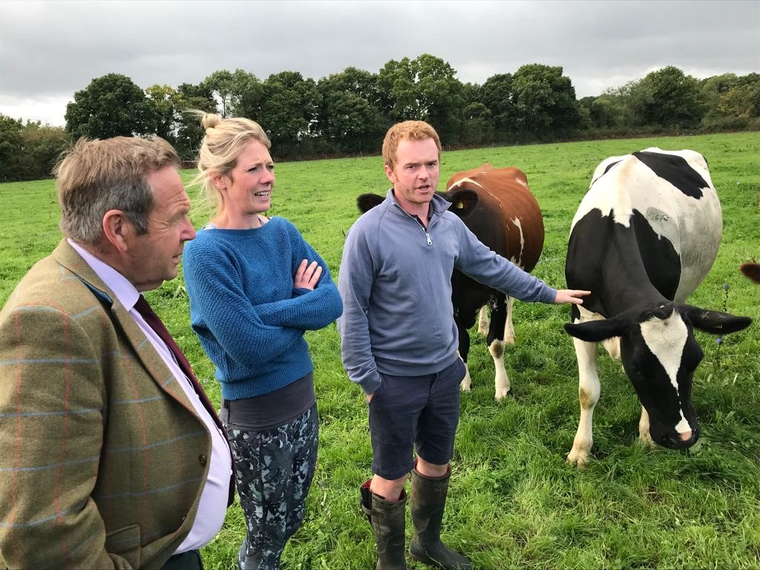
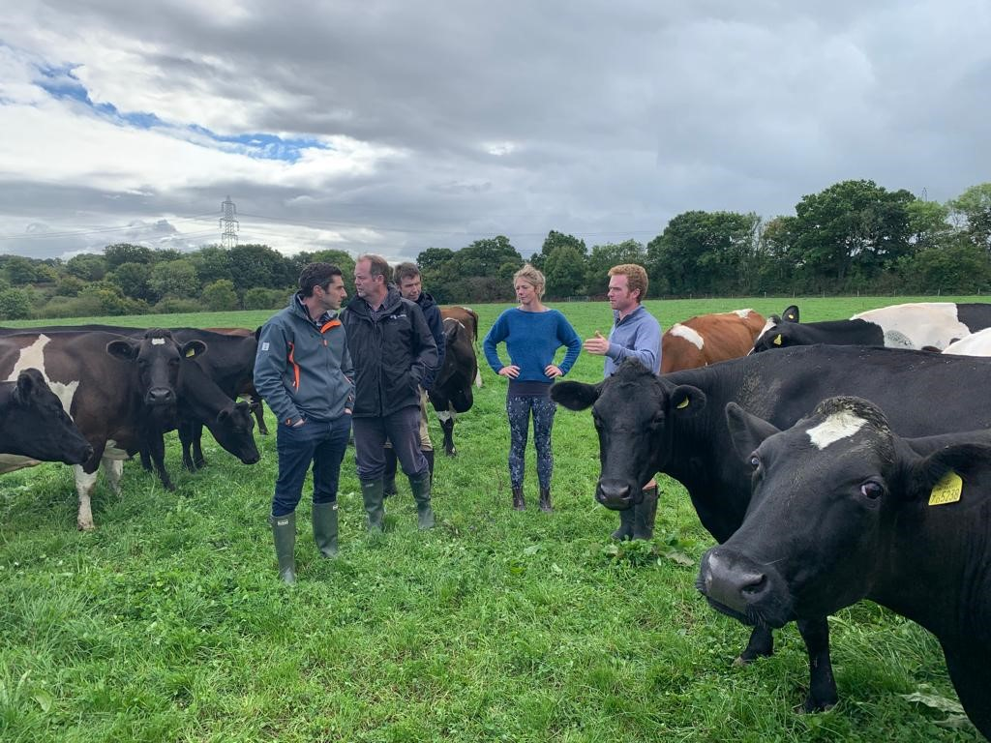
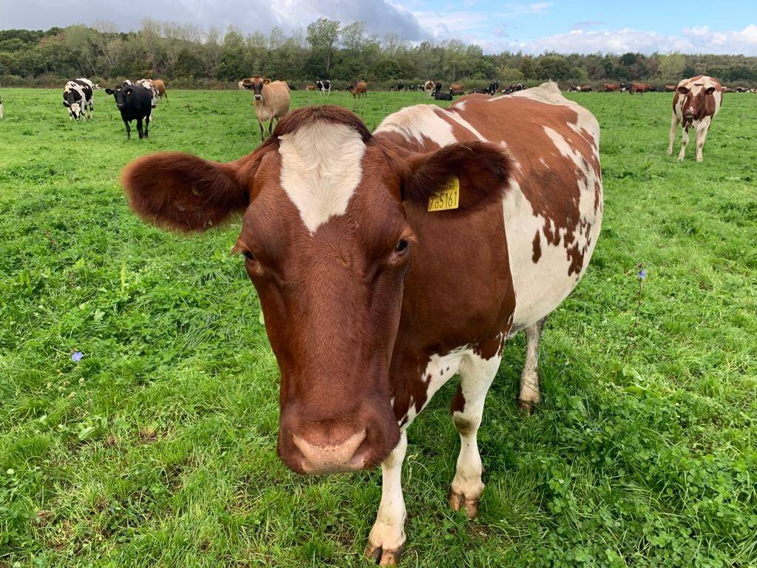

Slide 20
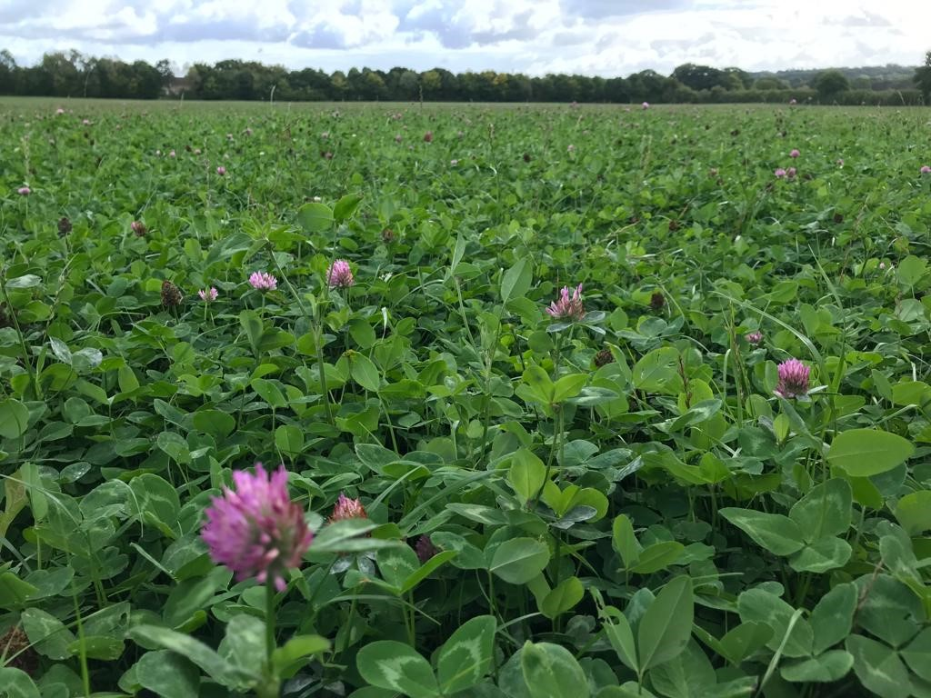
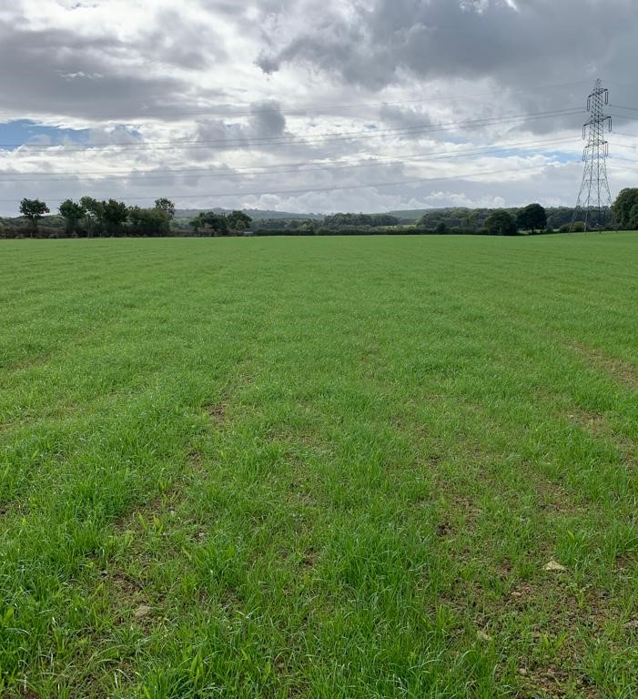

Slide 21
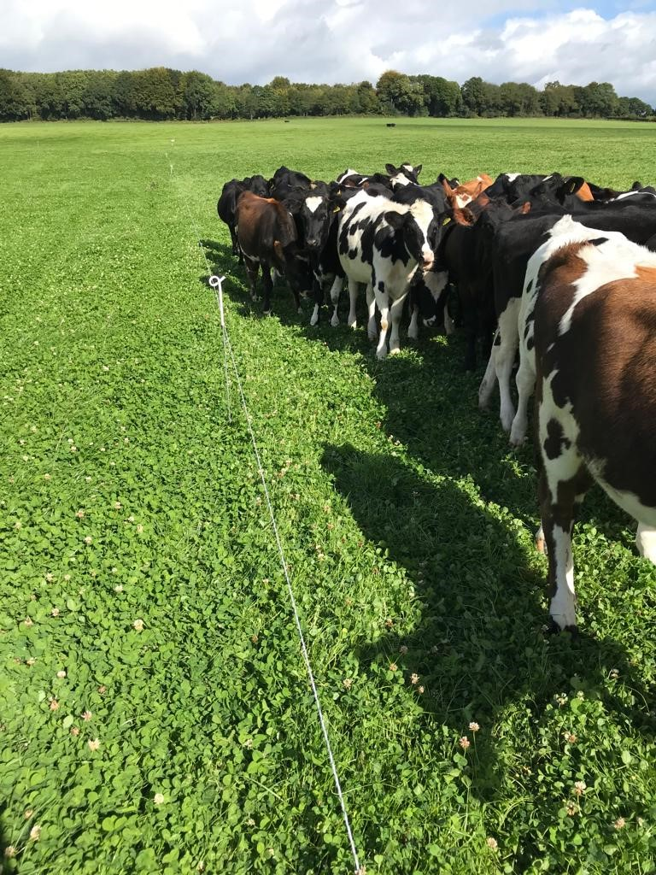
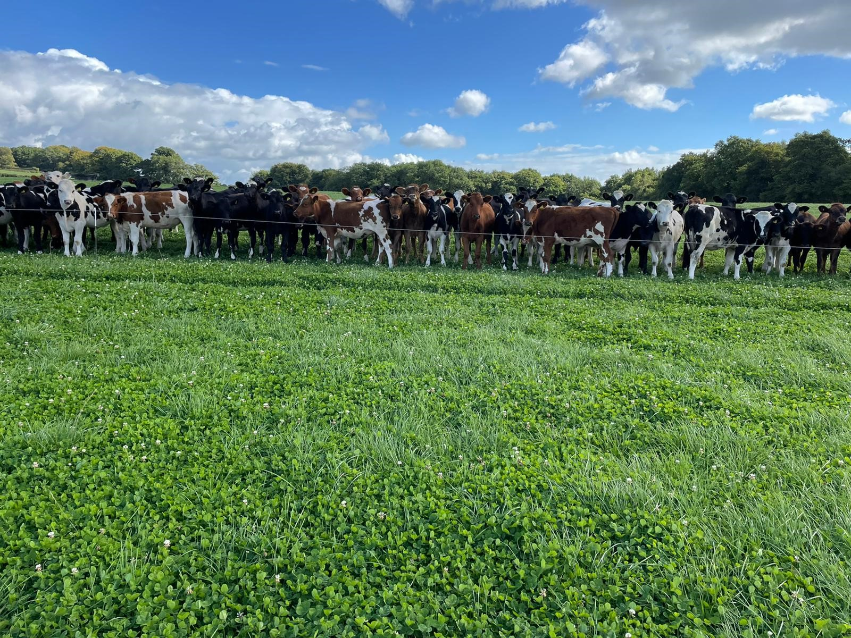

Slide 22
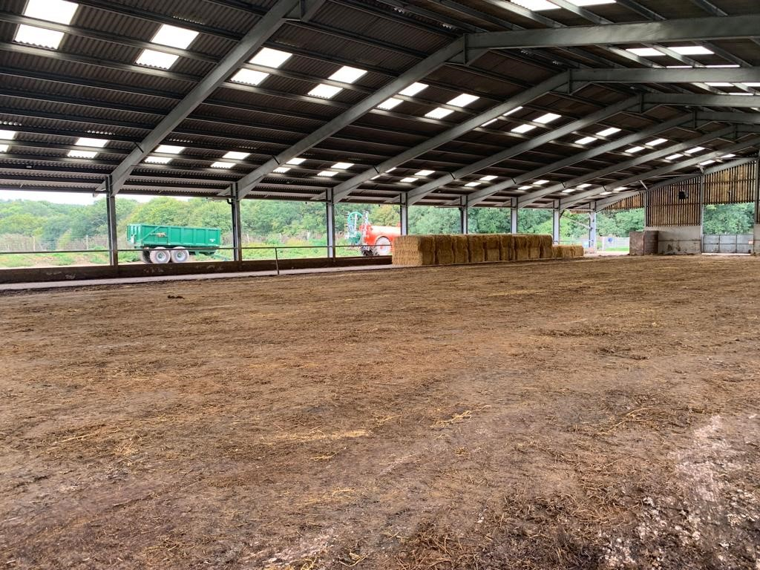
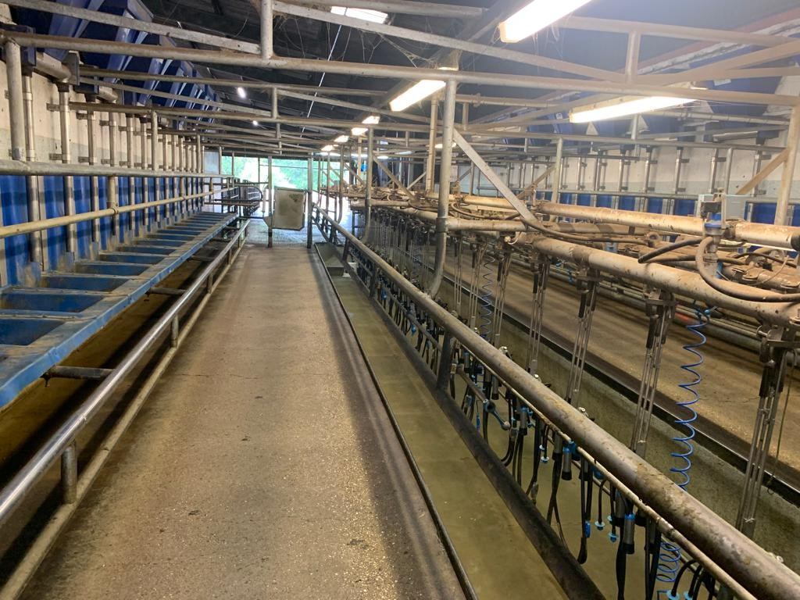

Slide 23
British Grassland Society
Grassland Farmer of the Year 2022
Thank you to our competition sponsors

